Slide 1

Geographical Statistics of Engineering Internships
CYLIA BERKANE
FAGNUO CAI
GUSTAVO FLEURY
INDURAJ PR
QUOC VIET PHAM
YEN CHU CHEN
April / 2019
Notes:
As próximas visitas serão compostas por 2 consultores;

Slide 2
AGENDA
1
3
Future Evolution/Conclusion
2
The Project
Technical Solutions
Management Solutions
4
5
Machine Learn Solutions

Slide 3
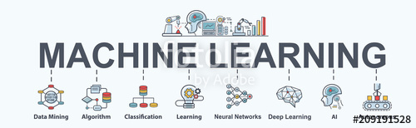


Introduction
Notes:
Data mining is the process of analyzing data from different sources and summarizing it into relevant information
that can be used to help increase revenue and decrease costs. Its primary purpose is to find correlations
or patterns among dozens of fields in large databases.
Machine learning in the other hand or statistical learning is a field of study of artificial intelligence that is
based on statistical approaches to give computers the ability to learn from data
La business intelligence (BI), c’est un peu tous les concepts précédents appliqués à la décision en entreprise.
This project consists in developing a solution of Geographical statistics of engineering internships, The dataset
that we have been assigned is EISTI students sites, internships and addresses. Our team choose to develop
a system that could help the school gain more knowledge on the geographical statistics of the engineering
internships chosen by student of both Cergy and Pau campus. We will be using all the methodes seen during
this year in ADEO1, Method like SIXO or Agile Method, Data Exploration method and programming languages.

Slide 4
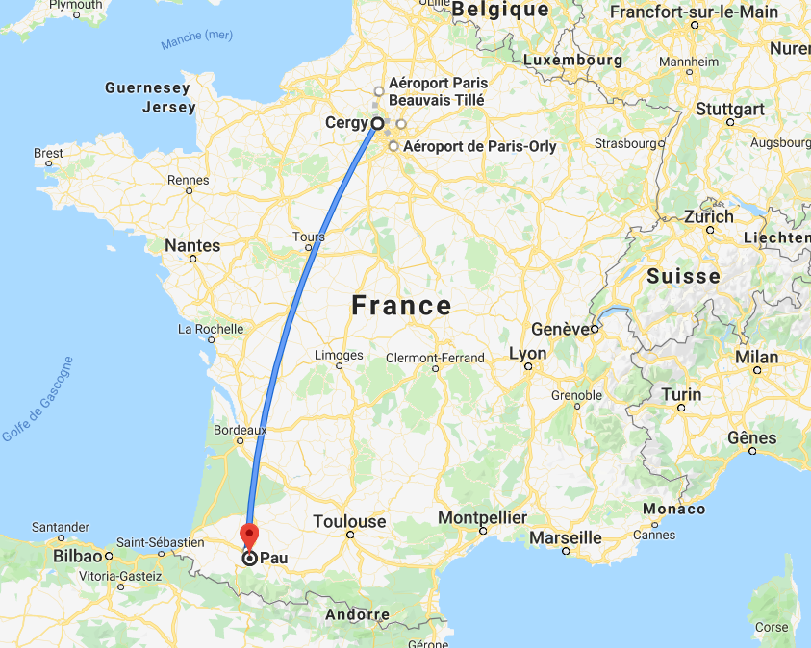

About EISTI
EISTI - recognized by CTI (French Engineering accreditation institution)
Cergy & Pau
Mathematics and Software engineering
Exchange students

Slide 5

Background of the project
Experience
Career path
Internships
But what makes them chose
A specific internship ?
Notes:
least few
hundred students relocate every semester to different geographical locations for the internships. But it is unclear
as what’s the choice of the students in choosing companies while applying for internships. It is thus crucial to
analyze the internship preference of the students from the available data so as to get thorough insight on if the
student preferred companies based on the distance between their home and campus or between their home and
location of the company or between campus and internships location! The thorough insight on the student’s
preference and about the companies that hire the EISTIEN’S will help the university in many ways such as
in adapting even more dynamic on-demand competitive edge curriculums, partnering with the companies for
giving on-campus training sessions and seminars, etc. These insights can also be used to define a model which
would predict as where the student is most likely to end up as intern!

Slide 6
Client needs & requirements
Upload CSV file and store it within a database.
Automatically clean the data;
Perform univariate and bivariate analysis and statistics that are defined in advance and can be configured;
Distance Calculation between the different locations.
User management (Login/Password /roles ).

Slide 7


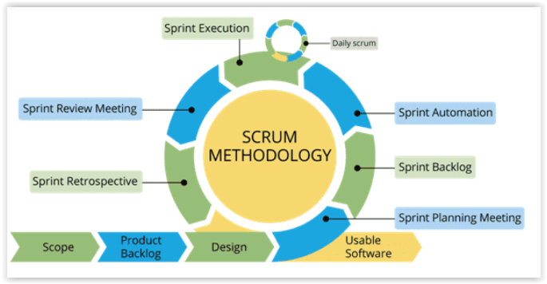
Management Solution - SCRUM
Notes:
-

Slide 8
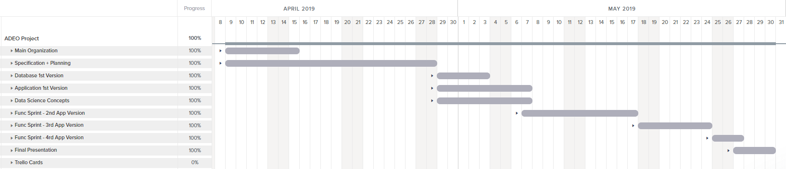
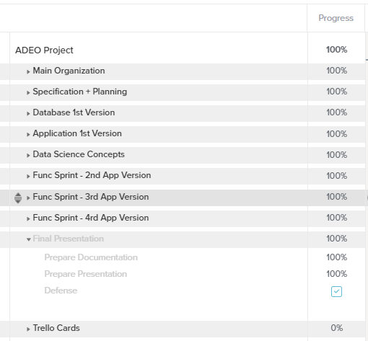
Management Solution - TeamGantt

Slide 9
Team Tasks Division
Infrastructure
Data Analysis / Statistics
Visualization / Documentation
Viet
Gustavo
Cai
Indu
Janet
Cylia
MANAGEMENT
Gustavo / Indu / Viet

Slide 10





Management Solutions
Backlog
Sync Problems

Slide 11


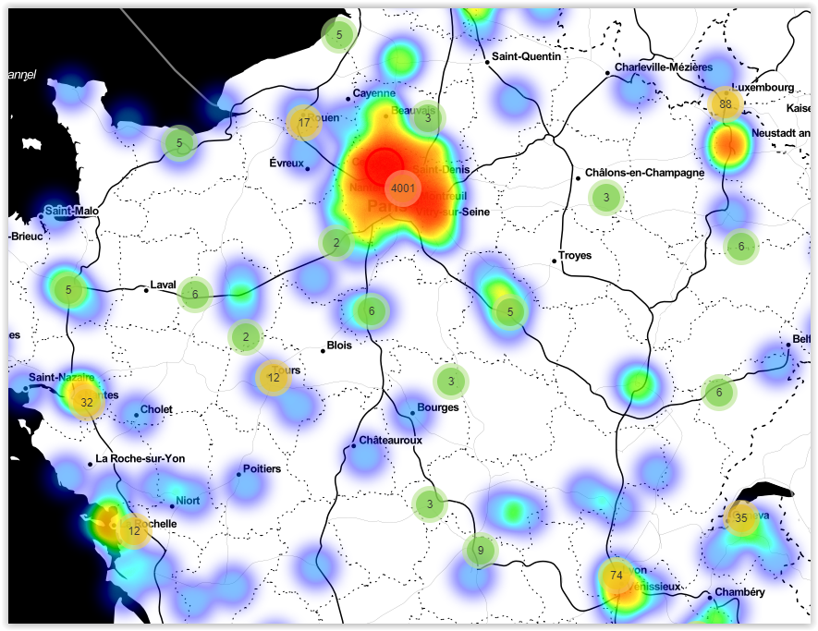





Technical Solutions
Bootstrap
Framework
Folium
Python
Chart.js
Database
ETL
Anaconda

Slide 12
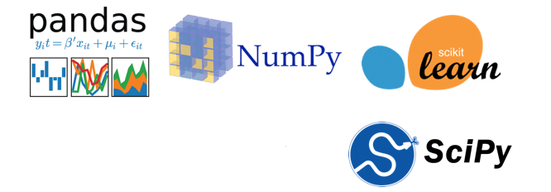
Python, Machine learning with Python
Python, Machine learing with Python:
Pandas: providing fast, flexible, and expressive data structures designed to make working with structured (tabular, multidimensional...) and time series data easy and intuitive.
Numpy: support for large, multi-dimensional arrays and matrices, along with a large collection of high-level mathematical functions to operate on these arrays.
Scikit-Learn: Scikit-learn provides a wide selection of supervised and unsupervised machine learning algorithms.

Slide 13
SQLite-Relational Database management system
SQLite (relational database management system): The lite in SQLite means light weight in terms of setup, database administration, and required resource.
SQLite has the following noticeable features: self-contained, serverless, zero-configuration, transactional.
Database
ETL

Slide 14
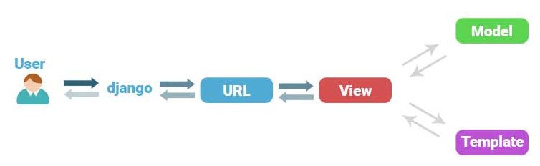
DJANGO MVC - MVT Pattern
Framework
Python
Anaconda
The Model-View-Template (MVT) is slightly different from MVC.
Django itself takes care of the Controller part (Software Code that controls the interactions between the Model and View), leaving us with the template.
The template is a HTML file mixed with Django Template Language (DTL).

Slide 15
User Interface
Bootstrap
Chart.js
Folium
Bootstrap is an open source toolkit for developing with HTML, CSS, and Java Script.
Responsive: with the increase in Smartphone usage, the demand for responsive websites has increased tremendously. A responsive layout and 12-column grid system are present in Bootstrap that aid in website adjustment according to screen size.
Chart.js: is a powerful data visualization library.
Folium: is another data visualization library in Python that was built primarily to help visualize geospatial data.

Slide 16

Machine Learn Solutions - ETL
PRG_STUDENT
_SITE
ADR_STUDENTS
STUDENT
_INTERNSHIP
Database
Merged Table

Slide 17

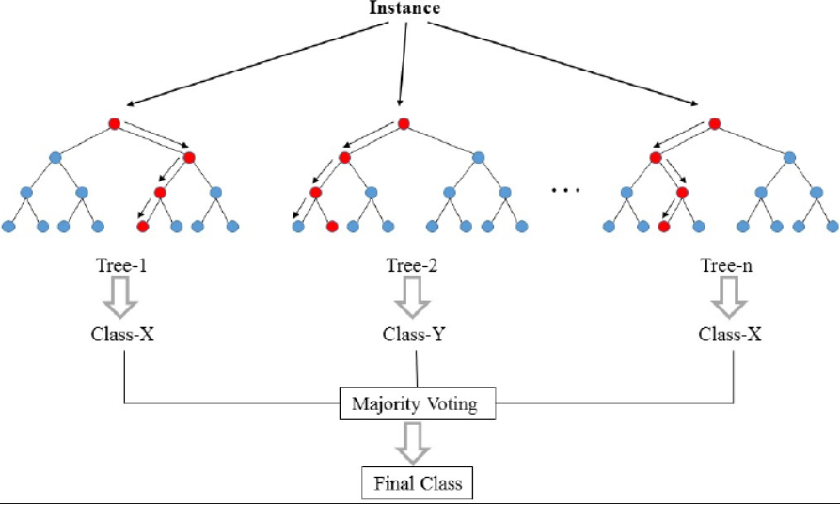
Random Forest
Remuneration
Source: https://fr.wikipedia.org/wiki/For%C3%AAt_d%27arbres_d%C3%A9cisionnels

Slide 18

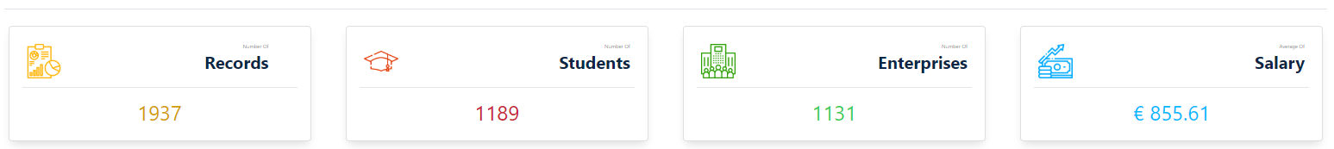

Random Forest - Comparative
+ 15% Data

Slide 19
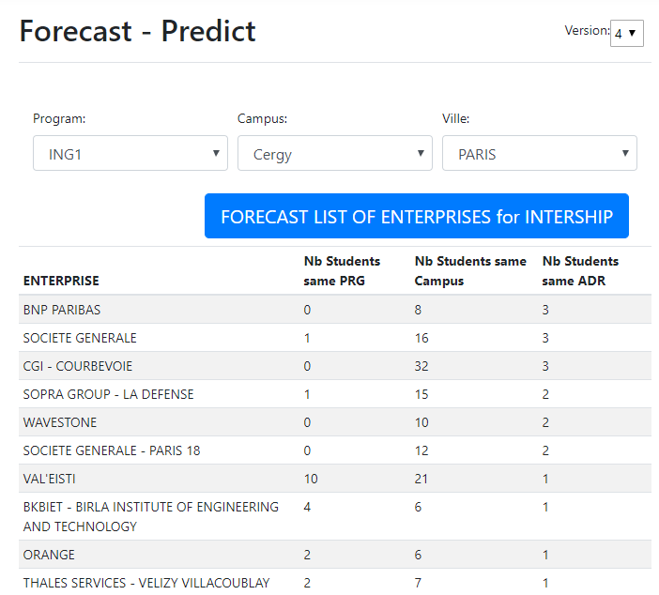
Intership Predict

Slide 20
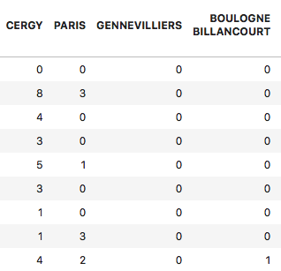
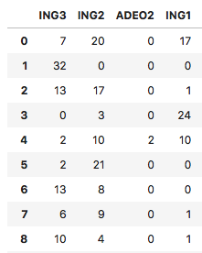
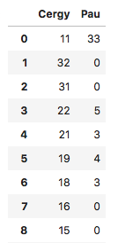
Internship Prediction - Algorithm
Program-Enterprise
Campus-Enterprise
Addresse-Enterprise

Slide 21




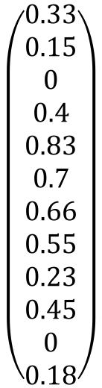
Internship Prediction - Algorithm
Decision?
$$\left(\begin{aligned}0.33 \\ 0.15 \\ 0 \\ 0.4 \\ 0.83 \\ 0.7 \\ 0.66 \\ 0.55 \\ 0.23 \\ 0.45 \\ 0 \\ 0.18\end{aligned}\right)$$
?
?
?
W0 ×
+ W1 ×
+ W2 ×
=

Slide 22
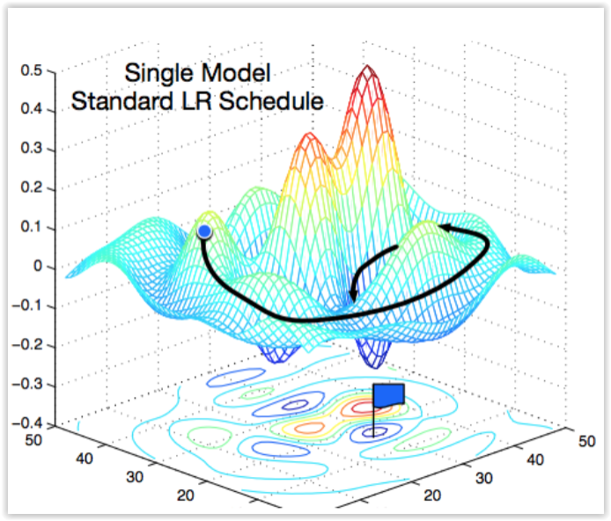
Gradient Descent
Source: https://medium.com/38th-street-studios/exploring-stochastic-gradient-descent-with-restarts-sgdr-fa206c38a74e

Slide 23

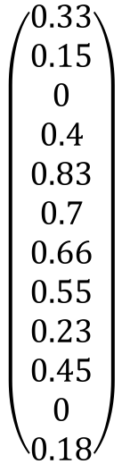

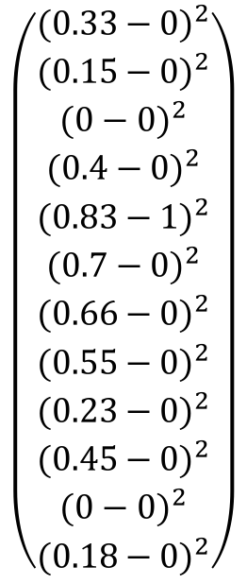
Gradient Descent – Cost Function
Output
Desired output
$$\left(\begin{aligned}{(0.33−0)}^{2} \\ {(0.15−0)}^{2} \\ {(0−0)}^{2} \\ {(0.4−0)}^{2} \\ {(0.83−1)}^{2} \\ {(0.7−0)}^{2} \\ {(0.66−0)}^{2} \\ {(0.55−0)}^{2} \\ {(0.23−0)}^{2} \\ {(0.45−0)}^{2} \\ {(0−0)}^{2} \\ {(0.18−0)}^{2}\end{aligned}\right)$$
$$\left(\begin{aligned}0.33 \\ 0.15 \\ 0 \\ 0.4 \\ 0.83 \\ 0.7 \\ 0.66 \\ 0.55 \\ 0.23 \\ 0.45 \\ 0 \\ 0.18\end{aligned}\right)$$
$$\left(\begin{aligned}0 \\ 0 \\ 0 \\ 0 \\ 1 \\ 0 \\ 0 \\ 0 \\ 0 \\ 0 \\ 0 \\ 0\end{aligned}\right)$$
$$C0=$$

Slide 24
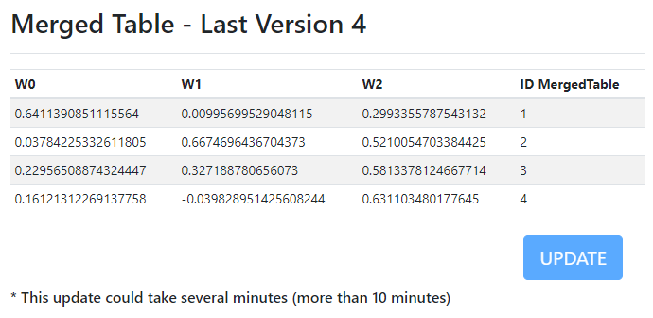
Intership Predict - Algorithm

Slide 25
Intership Predict – Performance Problem
Weight Calculations
Tables Transformations
Acceptable Response Time
> 10 minutes
> 55 seconds
<10 seconds
< 0.2 seconds
Register Values/Table in Database
Team Work

Slide 26

Address
VILLE, CODE_POSTAL, PAYS
Performance
GMaps API
MergedTable
Register LAT / LON in Database

Slide 27
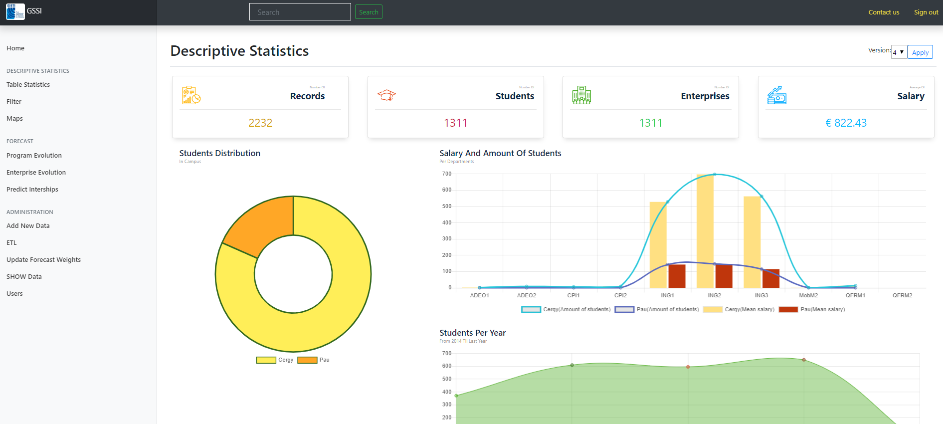
The System – Live Presentation

Slide 28

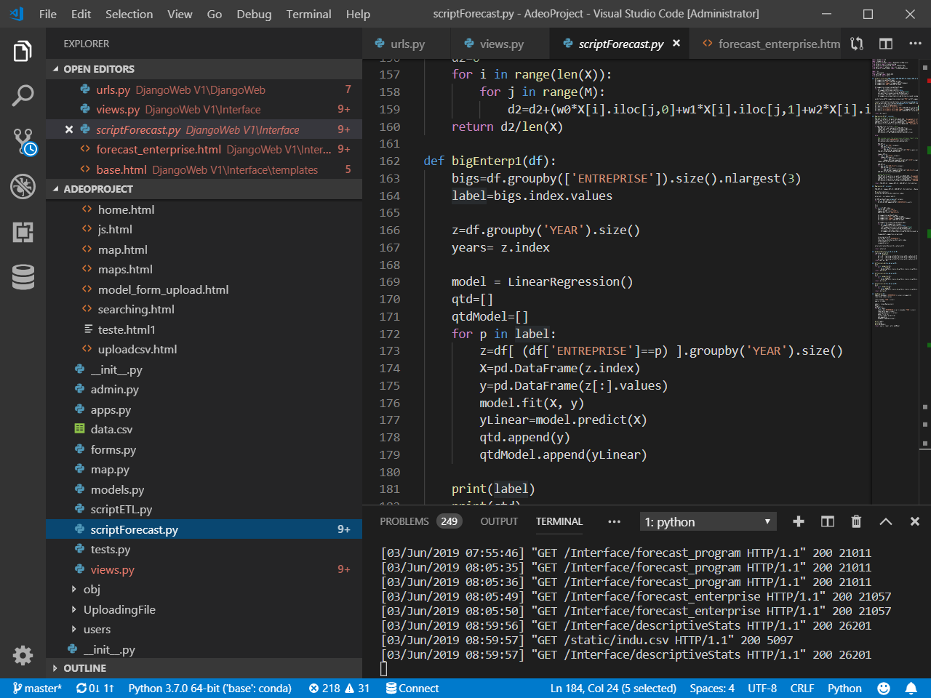
Documentation
CODE - Comments
2582 .PY Line Codes
PROJECT REPORT

Slide 29

Future Evolutions
More friendly user interface
with helps and Popups
Suggestion and Guiding error message
Uniform graph interfaces
Aditional graphs
Functionalities such as
Export reports (Ex: PDF) /Printing Options
More admin options, such as user priviledges
Problems with enterprise forecasting (name error’s)

Slide 30
Conclusions
This system developed as a prototype needs little more refinements;
With the refinements, making the system go online, it would be of much use for the actors of the system.

Slide 31
Thank you!
Questions?

